Slide 1
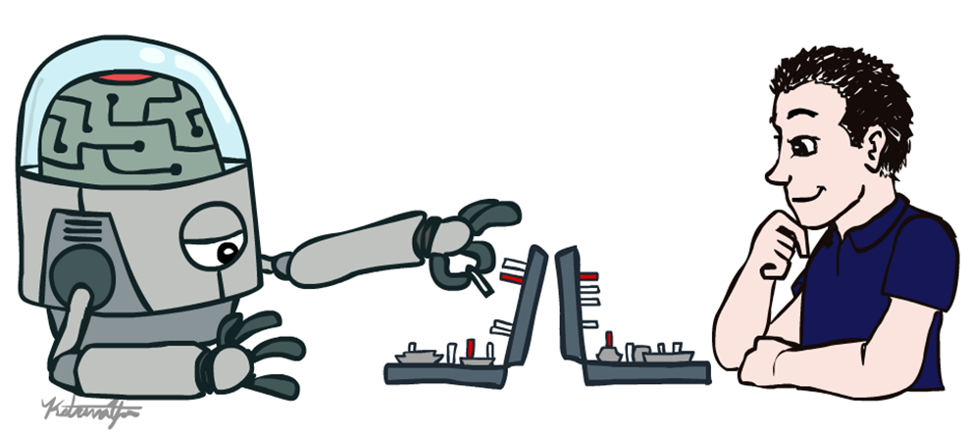
Artificial Intelligence
Introduction (b)
Dr. Rabia Tehseen
Assistant Professor
University of Central Punjab, Lahore
Modified slides of CS-188 Berkeley University

Slide 2
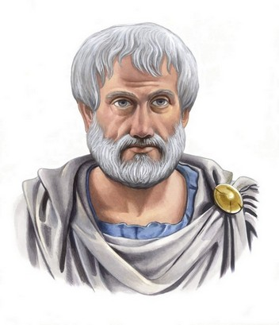
Thinking Rationally: Laws of Thought
Aristotle: First to codify “right thinking”
Several Greek schools developed various forms of logic:
Notation and rules of derivation for thoughts
Propositional logic, Predicate logic, etc.
Always yield correct conclusions when given correct premises
E.g. “Socrates is a man; all men are mortal; therefore, Socrates is mortal.”
These laws of thought were supposed to govern the operation of the mind; their study initiated the field called logic.

Slide 3
Thinking Rationally: Laws of Thought
Problems:
Not easy to state informal knowledge in logical notation
Mostly work for toy examples
Big difference between solving a problem "in principle" and solving it “in practice”
Problems with just a few hundred facts can exhaust the computational resources of any computer
How to measure if a program is thinking rationally
There is a difference between thinking and acting
Conclusion:
Right Thinking
Must have rules and logic
Complex and Hard

Slide 4
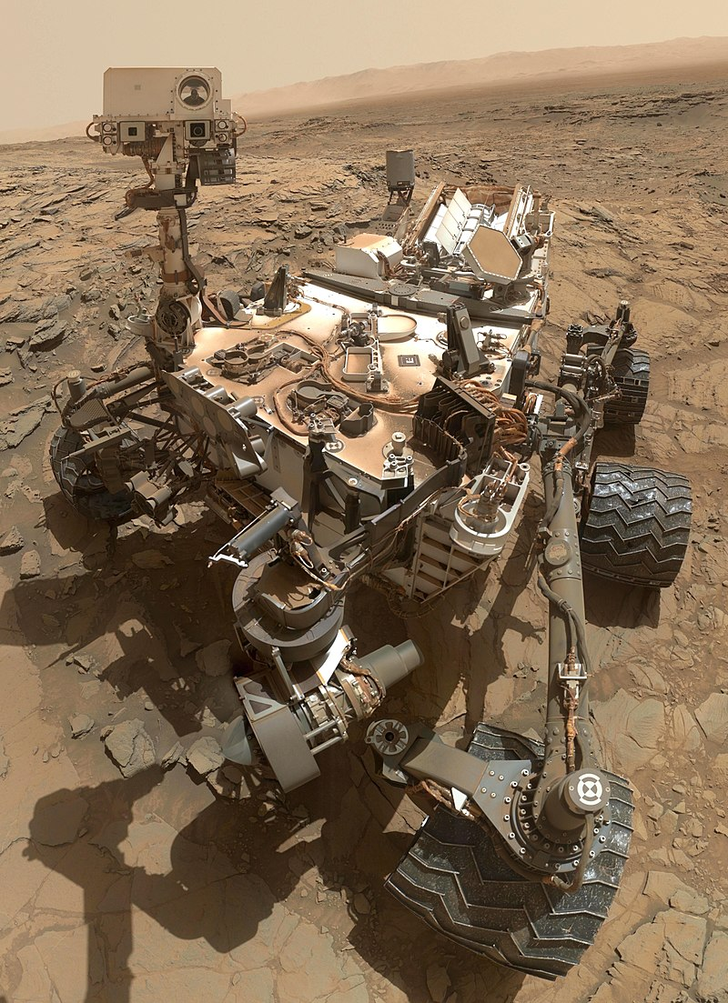
Acting rationally: Rational agent
An agent is something that acts.
All computer programs do something, but computer agents are expected to do more:
Operate autonomously,
Perceive their environment,
Persist over a prolonged time period
Adapt to change, and create and pursue goals.
Make correct inferences
Curiosity (rover)

Slide 5
Acting rationally: Rational agent
A rational agent is one that acts so as to achieve the best outcome or, when there is uncertainty, the best expected outcome.
Rational behavior: doing the right thing
The right thing: the optimal (best) thing that is expected to maximize the chances of achieving a set of goals, in a given situation
Making correct inferences is part of being a rational agent
There are also ways of acting rationally that cannot be said to involve inference -- Reflex actions.

Slide 6
Acting rationally: Rational agent
Advantages over other approaches
More general than the "laws of thought" approach
More obedient to scientific development than are approaches based on human behavior or human thought
Standard of rationality (Logic) is mathematically well defined and completely general
Conclusion:
Behave in right manner
Give max. Performance
Give Optimal Solution

Slide 7
This course is about designing
rational/intelligent agents
Build REPRESENTATIONS that
support MODELS targeted at
THINKING PERCEPTION ACTION

Slide 8
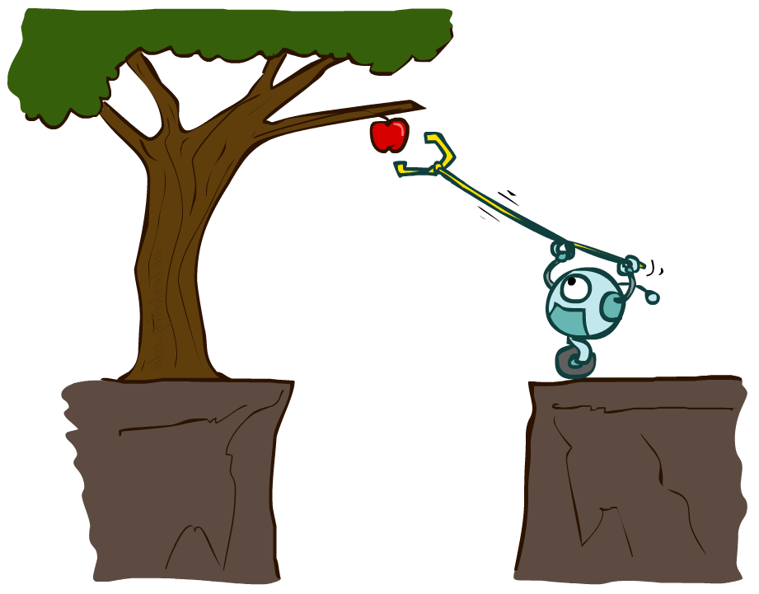
Designing Rational Agents
An agent is an entity that perceives and acts.
A rational agent selects actions that maximize its (expected) utility.
Characteristics of the percepts, environment, and action space dictate techniques for selecting rational actions
This course is about:
General AI techniques for a variety of problem types
Learning to recognize when and how a new problem can be solved with an existing technique
Sensors
Agent
Percepts
Environment
?
Actuators
Actions

Slide 9
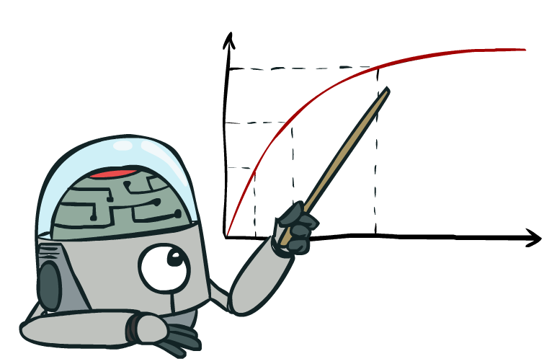
Rational Decisions
We’ll use the term rational in a very specific, technical way:
Rational: maximally achieving pre-defined goals
Rationality only concerns what decisions are made (not the thought process behind them)
Goals are expressed in terms of the utility of outcomes
Being rational means maximizing your expected utility
Notes:
Example of utilities. 10 for A, 1 for each Friday with friends

Slide 10
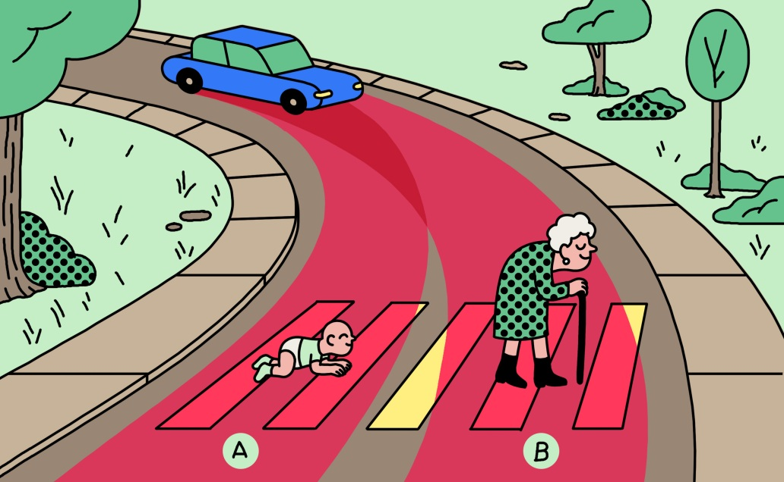

Slide 11
Approaches to AI
Strong AI
Strong AI aims to build machines that can truly reason and solve problems who is self aware and whose overall intellectual ability is indistinguishable from that of a human being.
Human-Like
Non-human Like
Weak AI
Weak artificial intelligence (weak AI), also known as narrow AI, is artificial intelligence that is focused on one narrow task.
Deals with the creation of some form of computer-based artificial intelligence that cannot truly reason and solve problems, but can act as if it were intelligent.
Siri is a good example of narrow intelligence.

Slide 12
Weak and Strong AI
Weak AI is AI that can not 'think', i.e. a computer chess playing AI does not think about its next move, it is based on the programming it was given, and its moves depend on the moves of the human opponent.
Strong AI is the idea/concept that we will one day create AI that can 'think' i.e. be able to play a chess game that is not based on the moves of the human opponent or programming, but based on the AI's own 'thoughts' and feelings and such, which are all supposed to be exactly like a real humans thoughts and emotions and stuff.

Slide 13
Quick Quiz
To what extent are the following computer systems instances of artificial intelligence:
Supermarket bar code scanners.
Web search engines.
Voice-activated telephone menus.

Slide 14
Applications of AI
Game playing
Computer vision
Natural language processing
Diagnosis systems
Control
Optimisation
Robotics

Slide 15
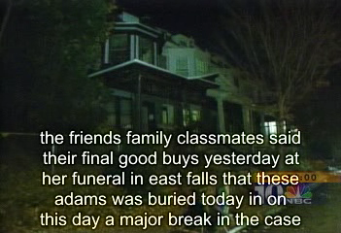
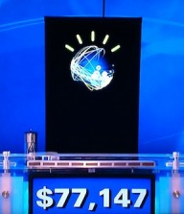
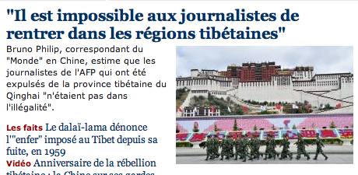
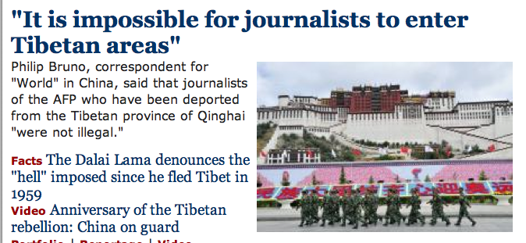
Natural Language
Speech technologies (e.g. Siri)
Automatic speech recognition (ASR)
Text-to-speech synthesis (TTS)
Dialog systems
Language processing technologies
Question answering
Machine translation
Web search
Text classification, spam filtering, etc…

Slide 16
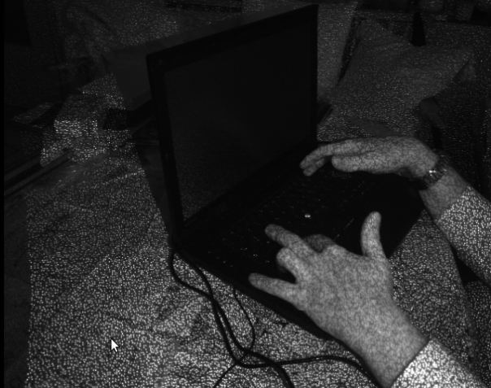

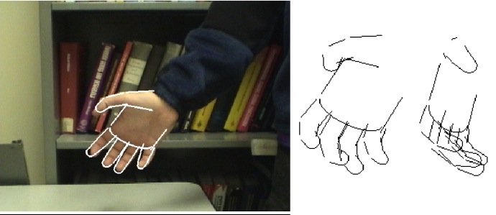
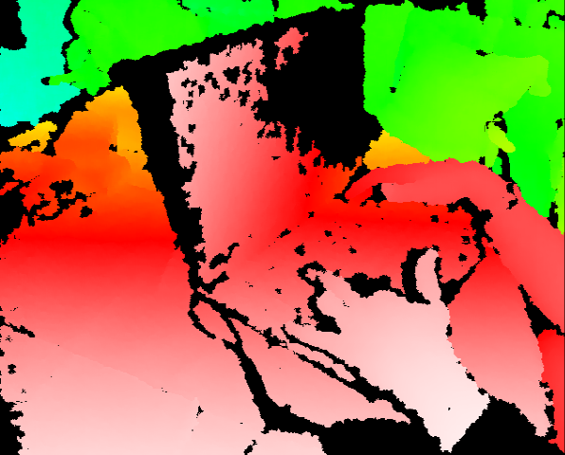
Vision (Perception)
Object and face recognition
Scene segmentation
Image classification

Slide 17
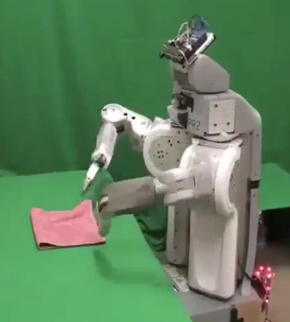
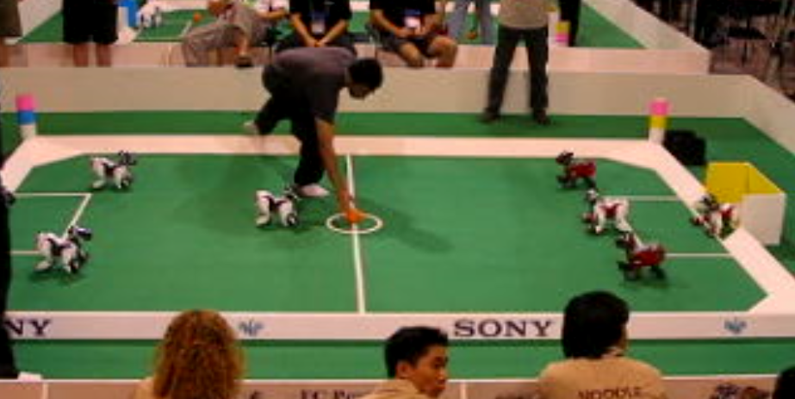
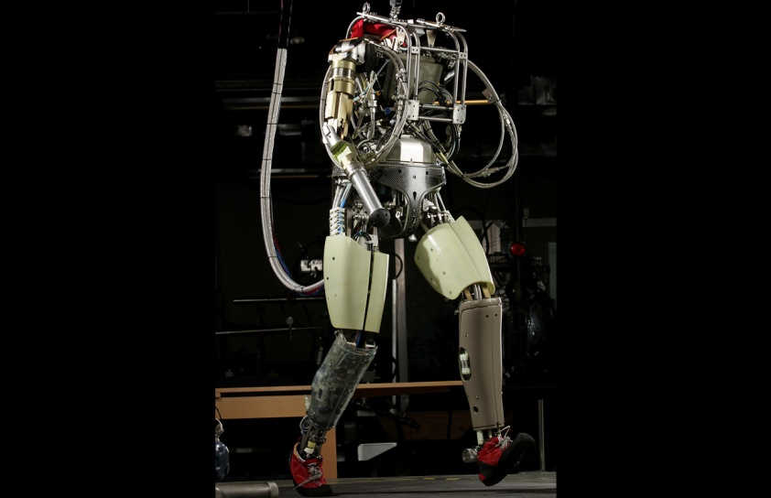
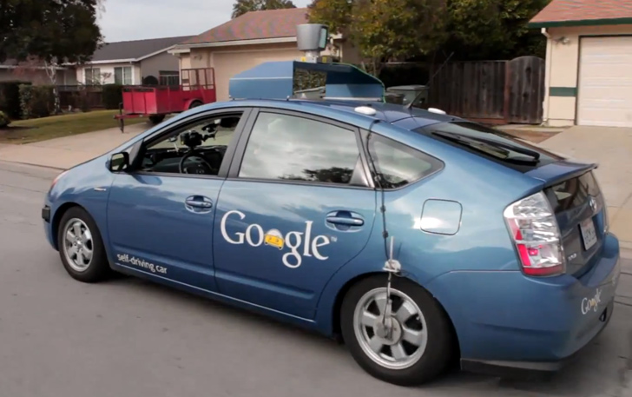
Robotics
Robotics
Technologies
Vehicles
Rescue
Soccer!
Lots of automation…

Slide 18
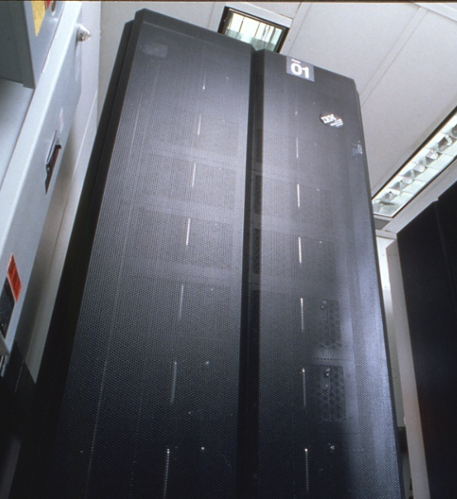
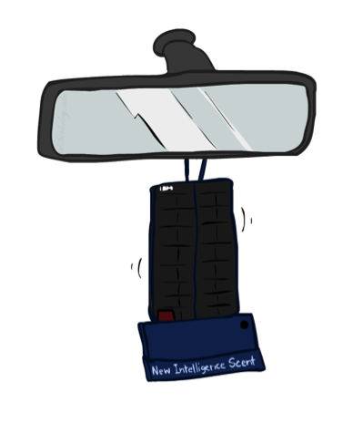
Game Playing
Classic Moment: May, '97: Deep Blue vs. Kasparov
First match won against world champion
“Intelligent creative” play
200 million board positions per second
Humans understood 99.9 of Deep Blue's moves
Can do about the same now with a PC cluster
Open question:
How does human cognition deal with the
search space explosion of chess?
Or: how can humans compete with computers at all??
1996: Kasparov Beats Deep Blue
“I could feel --- I could smell --- a new kind of intelligence across the table.”
1997: Deep Blue Beats Kasparov
“Deep Blue hasn't proven anything.”
Huge game-playing advances recently, e.g. in Go!
Notes:
Yeah, Kasparov comment probably says more about humans than about computers

Slide 19

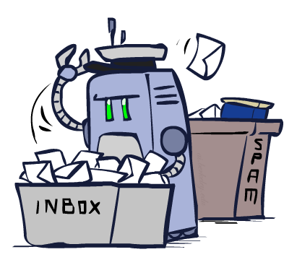
Decision Making
Applied AI involves many kinds of automation
Scheduling, e.g. airline routing, military
Route planning, e.g. Google maps
Medical diagnosis
Web search engines
Spam classifiers
Automated help desks
Fraud detection
Product recommendations
… Lots more!
Notes:
All applications can be thought of as decision making or useful sub-components of decision making

Slide 20
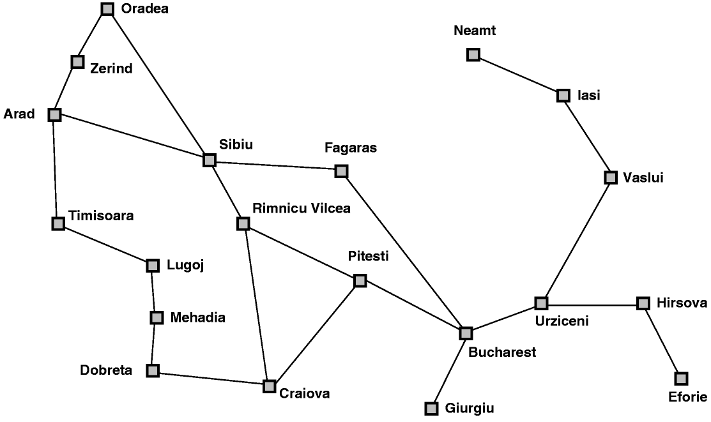
AI Topics: A Quick Introductory Overview
Classic AI search problems: Map searching (navigation)

Slide 21
AI Topics: A Quick Introductory Overview
Classic AI search problems
3*3*3 Rubik’s Cube

Slide 22
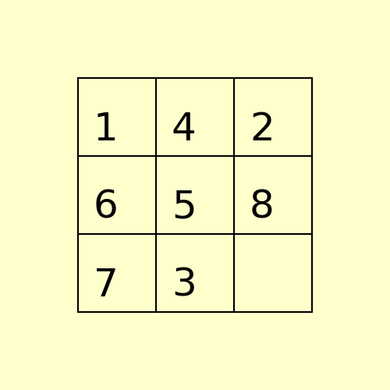
Classical AI Search Problems
8-Puzzle
1
4
2
1
2
3
6
5
8
4
5
6
7
3
7
8

Slide 23

Classical AI Search Problems

Slide 24
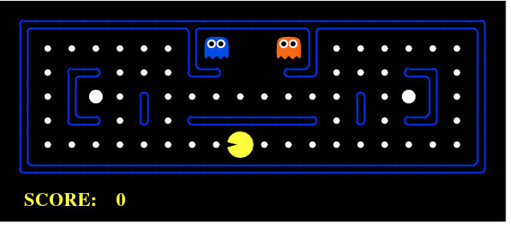
Classical AI Search Problem
Pac-Man

Slide 25
Important Features of Artificial Intelligence
The use of computers to do reasoning, pattern recognition, learning, or some other form of inference.
A focus on problems that do not respond to algorithmic solutions. This underlies the reliance on heuristic search as an AI problem-solving technique.
A concern with problem-solving using inexact, missing, or poorly defined information and the use of representational formalisms that enable the programmer to compensate for these problems.
Reasoning about the significant qualitative features of a situation.
An attempt to deal with issues of semantic meaning as well as syntactic form.
Answers that are neither exact nor optimal, but are in some sense “sufficient”. This is a result of the essential reliance on heuristic problem-solving methods in situations where optimal or exact results are either too expensive or not possible.
The use of large amounts of domain-specific knowledge in solving problems. This is the basis of expert systems.
The use of meta-level knowledge to effect more sophisticated control of problem-solving strategies. Although this is a very difficult problem, addressed in relatively few current systems, it is emerging as an essential are of research.

